Slide 1

AUTOMATIC PLANT
WATERING SYSTEM

Slide 2

LIST OF COMPONENTS & BUDGET
NO | COMPONENTS | QUANTITY | RATE | AMOUNT
1 | AURDINO UNO | 1 | 1000 | 1000
2 | MOISTURE SENSOR | 1 | 70 | 70
3 | 1 CHANNEL RELAY MODULE | 1 | 50 | 50
4 | SUBMERSIBLE PUMP | 1 | 70 | 70
5 | SPDT ON-OFF SWITCH | 1 | 15 | 15
6 | JUMPER WIRE | 30 | 1.5 | 45
7 | PIPE | 1 | 20 | 20
8 | CONTAINER | 1 | 30 | 30
9 | POT | 2 | 100 | 200
10 | ADAPTER 6V | 1 | 100 | 100
11 | Connecting Wire | 1 | 20 | 20
TOTAL |  |  |  | 1620

Slide 3

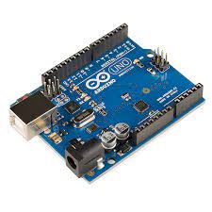




Arduino Uno Specification
Microcontroller: ATmega328P
Operating Voltage: 5V
Input Voltage (recommended): 7-12V
Input Voltage (limit): 6-20V
Digital I/O Pins: 14 (of which 6 provide PWM output)
PWM Digital I/O Pins: 6
Analog Input Pins: 6
DC Current per I/O Pin: 20 mA
DC current for 3.3V Pin: 50 mA
Flash Memory: 32 KB (ATmega328P) of which 0.5 KB used by bootloader
SRAM: 2 KB (ATmega328P)
EEPROM: 1 KB (ATmega328P)
Clock Speed: 16 MHz
LED_BUILTIN: 13
Length: 68.6 mm
Width: 58.4 mm
Weight: 25 g

Slide 4
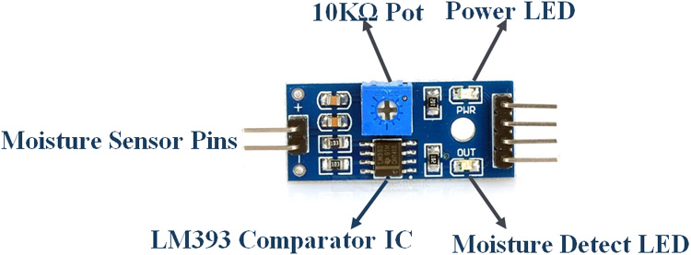
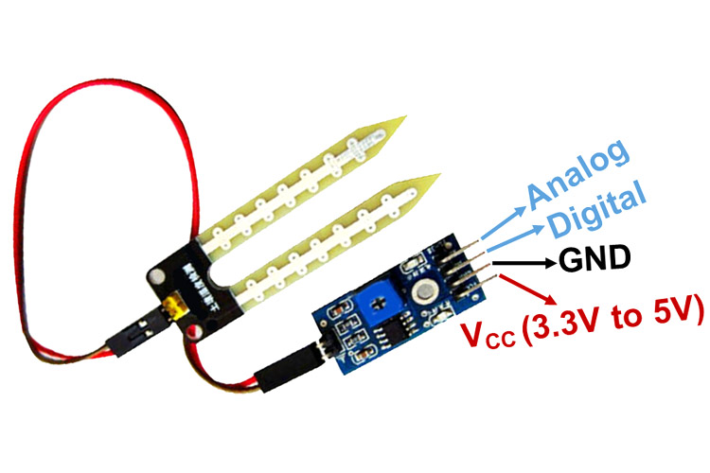
Soil Moisture Sensor Module Specifications
Operating Voltage: 3.3V to 5V DC
Operating Current: 15mA
Output Digital - 0V to 5V, Adjustable trigger level from preset
Output Analog - 0V to 5V based on infrared radiation from fire flame falling on the sensor
LEDs indicating output and power
PCB Size: 3.2cm x 1.4cm
LM393 based design
Easy to use with Microcontrollers or even with normal Digital/Analog IC
Small, cheap and easily available

Slide 5
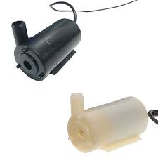
Submersible Mini Water Pump - 3-6V DC
Operating Voltage : 3 ~ 6V
Operating Current : 130 ~ 220mA
Flow Rate : 80 ~ 120 L/H
Maximum Lift : 40 ~ 110 mm
Continuous Working Life : 500 hours
Driving Mode : DC, Magnetic Driving
Material : Engineering Plastic
Outlet Outside Diameter : 7.5 mm
Outlet Inside Diameter : 5 mm

Slide 6
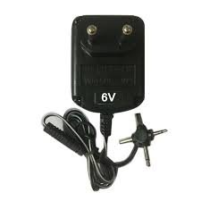
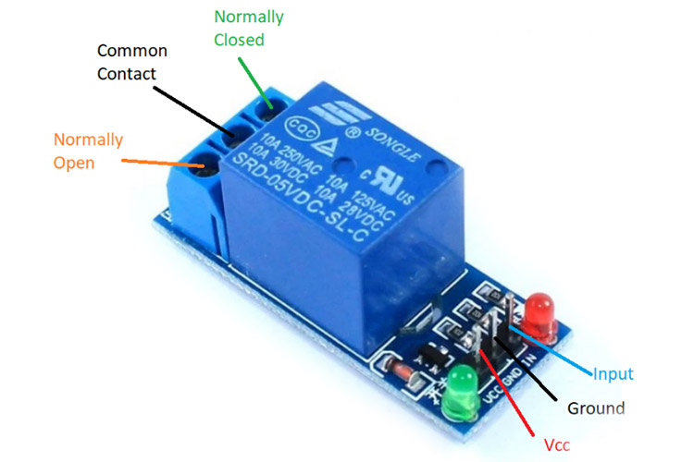
Adapter 6v
Input - 100-240 VAC 50/60Hz
Category - Switch Mode Power Adaptor (SMPS)
Output Type - DC
Output - 6Volts 1Amp
Single Channel Relay Module Specifications
Supply voltage – 3.75V to 6V
Quiescent current: 2mA
Current when the relay is active: ~70mA
Relay maximum contact voltage – 250VAC or 30VDC
Relay maximum current – 10A

Slide 7
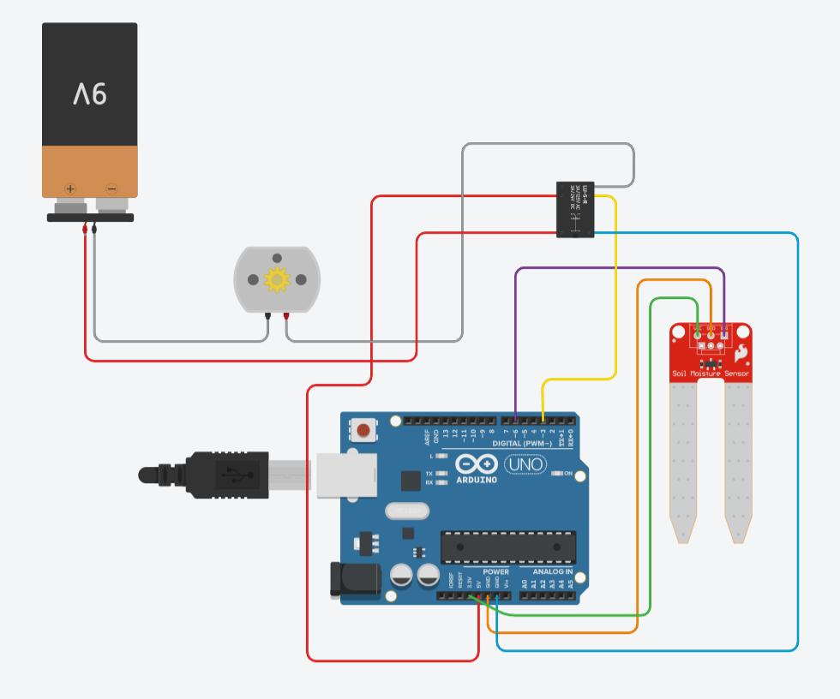


Slide 8
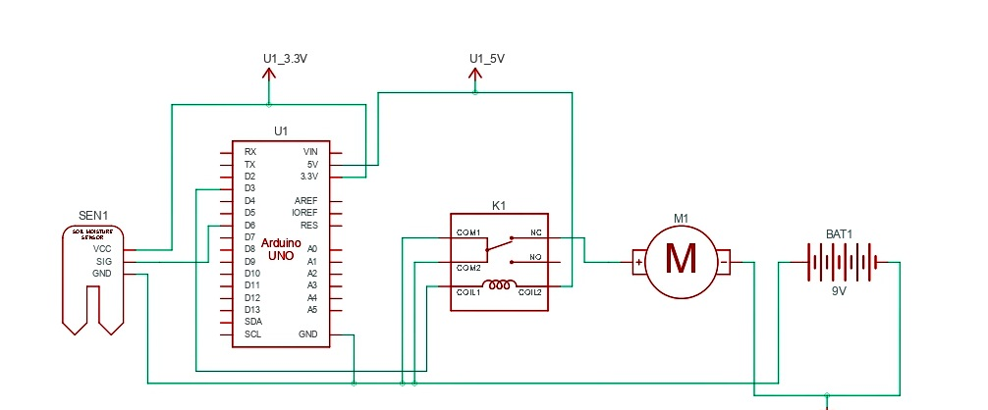
Circuit Diagram :-

Slide 9

C++ CODE
Int water; //random variable void setup() { pinMode(3,OUTPUT); //output pin for relay board, this will sent signal to the relay pinMode(6,INPUT); //input pin coming from soil sensor } void loop() { water = digitalRead(6); // reading the coming signal from the soil sensor if(water == HIGH) // if water level is full then cut the relay { digitalWrite(3,LOW); // low is to cut the relay } else { digitalWrite(3,HIGH); //high to continue proving signal and water supply } delay(1000); }

Slide 10


